Slide 1


Securing Our AI Future: A Strategic Approach to Governing Agentic AI
Company Logo Here
A CISO Briefing for the Executive Leadership Team
[CISO Name]
[DATE]

Slide 2
A Guide for the CISO: How to Use This Presentation
PURPOSE: This template is designed to help you build a compelling business case for investing in a dedicated AI-focused API security program. It is not a technical deep dive; it is a strategic narrative that connects your organization's AI initiatives directly to business risk and a clear, actionable security plan.
BEST WAYS TO USE IT:
Customize It: Fill in the placeholders on slides 3 and 7 with your own project names and best-effort data. The goal is to make the risks feel specific to your organization. Remove slides that don’t make sense or add in any additional slides based on AI projects currently in progress.
Facilitate a Discussion: Use the "Key Questions" and "Scenario" slides (12 and 14) as interactive workshop prompts. The goal is to have your stakeholders arrive at the conclusion that a gap exists.
Tell a Story: The presentation follows a deliberate narrative: the business opportunity of AI, the hidden risk of APIs, the failure of old tools, and the clear path forward. Use the speaker notes to guide this story.
WHO SHOULD BE IN THE ROOM:
Primary Audience: Executive Leadership Team (CIO, CTO, CRO, Head of Digital Transformation).
Key Stakeholders: Leaders from Application Development, Cloud Architecture, and Legal/Compliance. This ensures a holistic discussion that balances innovation, security, and governance.

Slide 3

AI is a Core Enabler of Our 2026 Business Goals [CISO TO UPDATE PROJECTS]
Project 1: Customer Service Automation
  Goal: Reduce support ticket resolution time by 30%.
  Business Impact: Increased customer satisfaction.
Project 2: Supply Chain Optimization
  Goal: Improve demand forecasting accuracy by 15%.
  Business Impact: Reduced inventory costs.
Project 3: [Insert Your Own Project Name]
  Goal: [Insert Project Goal]
  Business Impact: [Insert Business Impact]
Notes:
As we all know, AI is no longer a future concept; it's a critical part of our strategy to innovate and compete. Today, I want to talk about how we are going to secure these transformative initiatives to ensure we can realize their full value without introducing unacceptable risk.

Slide 4
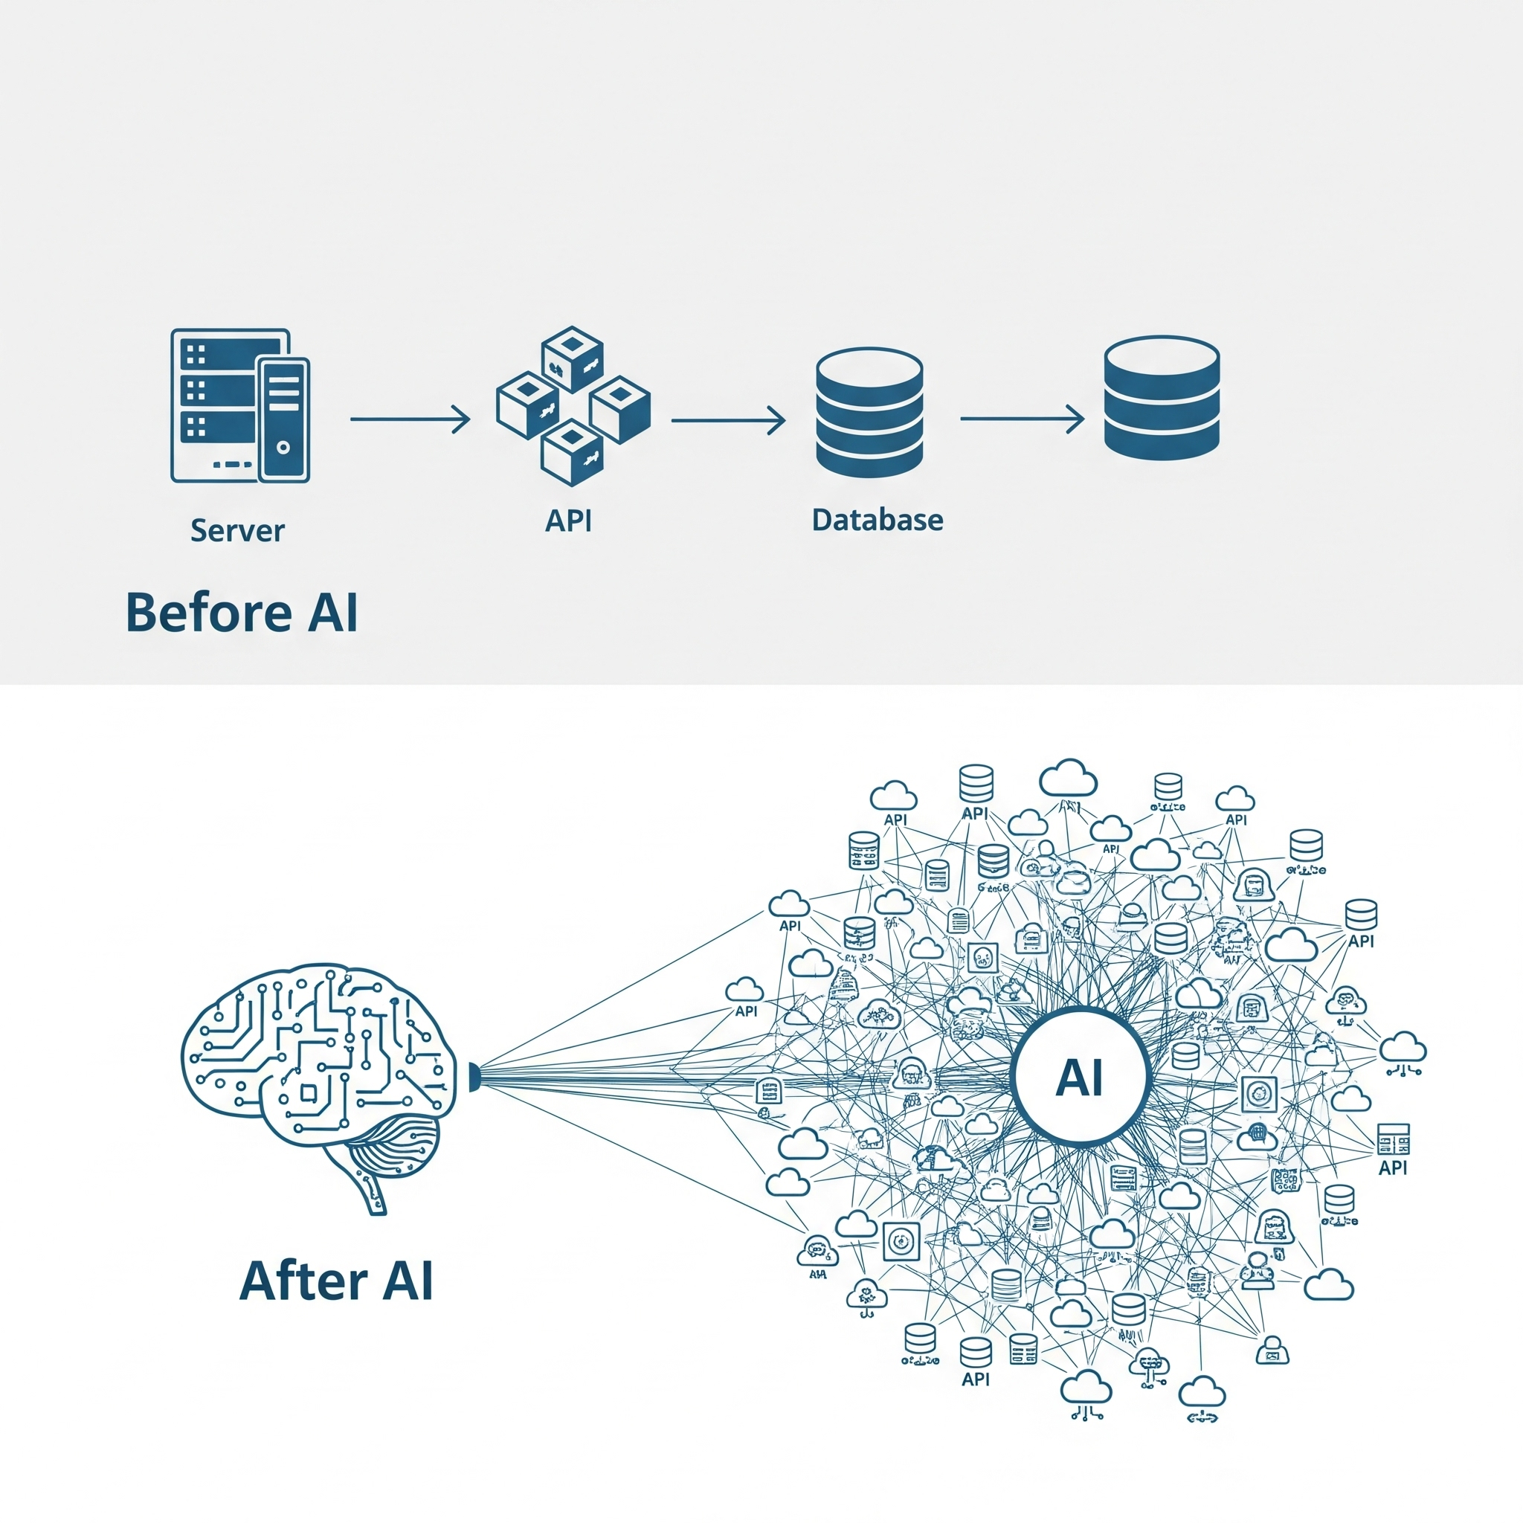
Every Action Our AI Agents Take is an API Call
Our AI agents rely on a vast network of APIs to access data and perform their functions.
This creates an exponential increase in API traffic, a complex and largely unseen web of interactions.
Our API security posture has become the foundational control plane for our entire AI strategy.
Notes:
To understand how we secure AI, we first need to understand how AI works. It's not magic; it's a system of autonomous agents interacting with our core business systems through APIs. This fundamentally changes our security landscape. The conversation about AI security is, at its core, a conversation about API security.

Slide 5
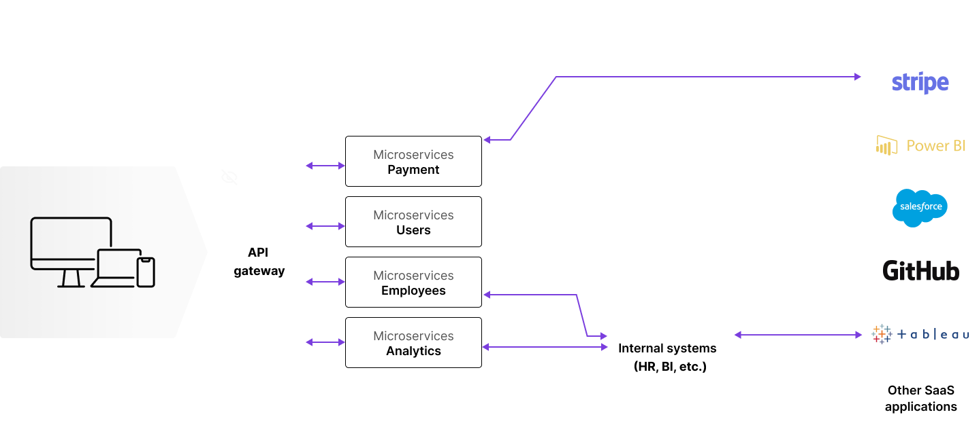
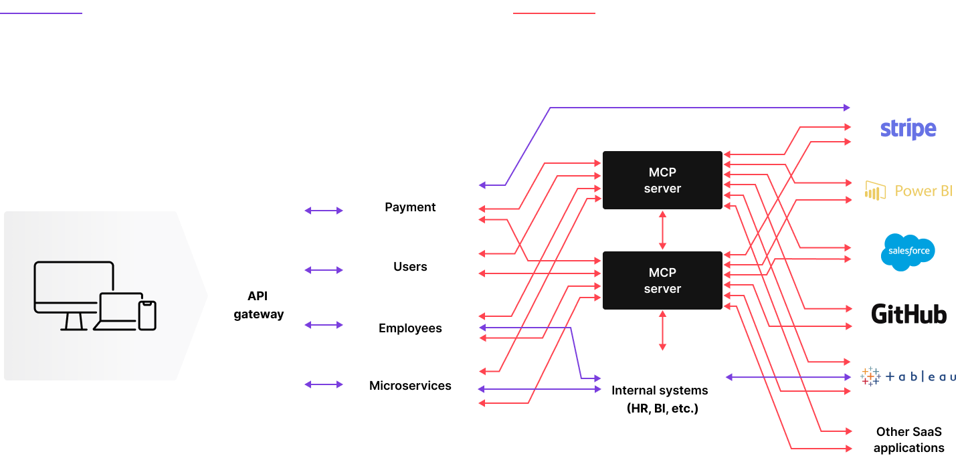
Every AI agent expands your API Fabric
The discover, posture and threat protection problem is now 100x larger.

Slide 6
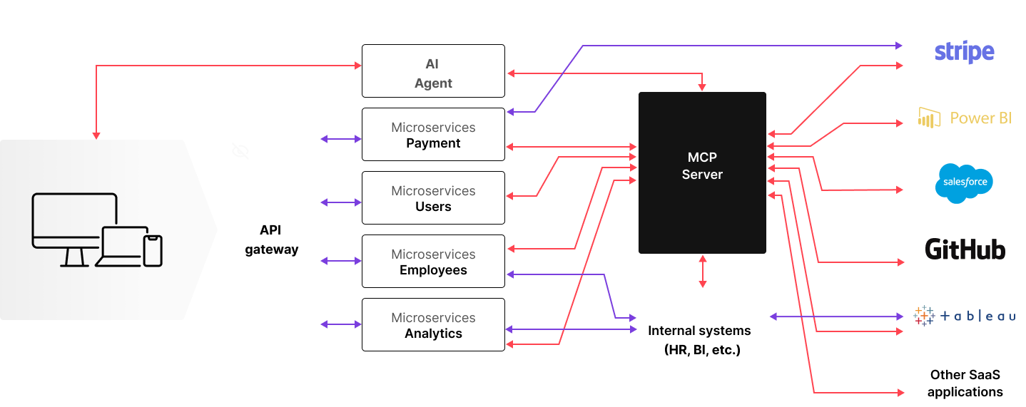
Every AI agent expands your API Fabric
The discover, posture and threat protection problem is now 100x larger.

Slide 7
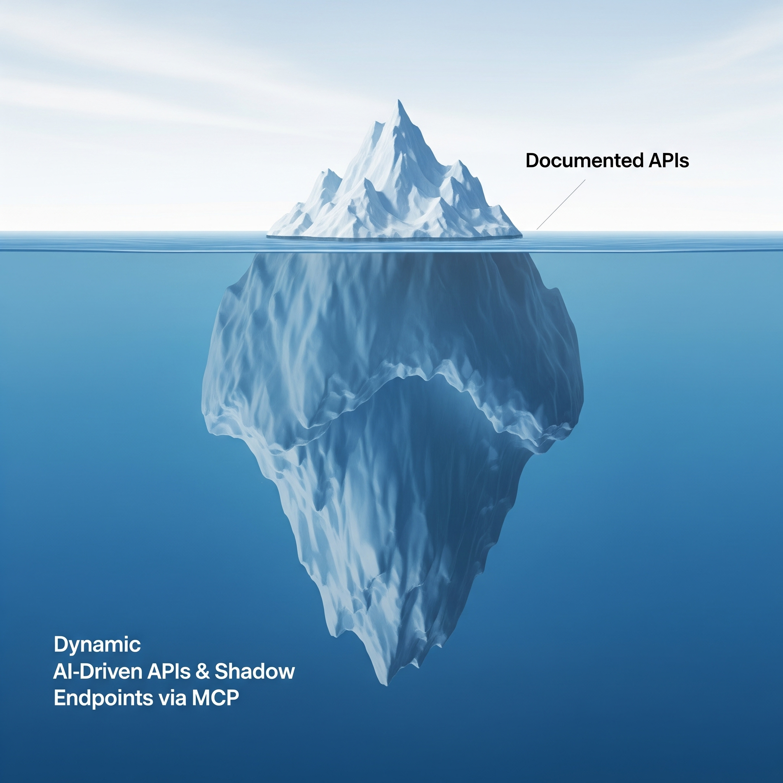
AI Agents and MCP Servers Make Our Attack Surface Dynamic and Unpredictable
Static "Pre-AI" Inventory (from CMDB): [Enter number from current documentation]
New AI Agent Endpoints (Known): [Enter number of known APIs for AI initiatives]
Dynamic API Connections via MCP Servers: This is our critical unknown. These are created on-the-fly and are not in any static inventory.
Key Concern: Our traditional inventory is a static map. AI agents operate on a constantly changing, dynamic landscape. We lack the real-time visibility to see the thousands of new API connections they create.
Notes:
We can't protect what we can't see. Our traditional inventory, shown at the tip of the iceberg, is static. But AI agents, communicating through MCP servers, create and consume APIs dynamically. This means our attack surface is no longer a fixed map but a constantly changing landscape hidden from view. This is a visibility problem of a different order of magnitude, and it's our most critical blind spot.

Slide 8

Why AI agents magnify the API security problem
Expanded Attack Surface
Sensitive Data Leakage
New Attack Vectors
MCP servers and AI agents multiply API endpoints and connections, creating countless new entry points for attackers.
Autonomous API calls and broad integrations can unintentionally leak sensitive data across internal and external systems.
AI agents can be manipulated (e.g., via prompt injection or data poisoning) to trigger sensitive APIs or perform unauthorized actions.
Notes:
Goal: Position Salt as the best-in-class platform for solving the right problems.

Slide 9
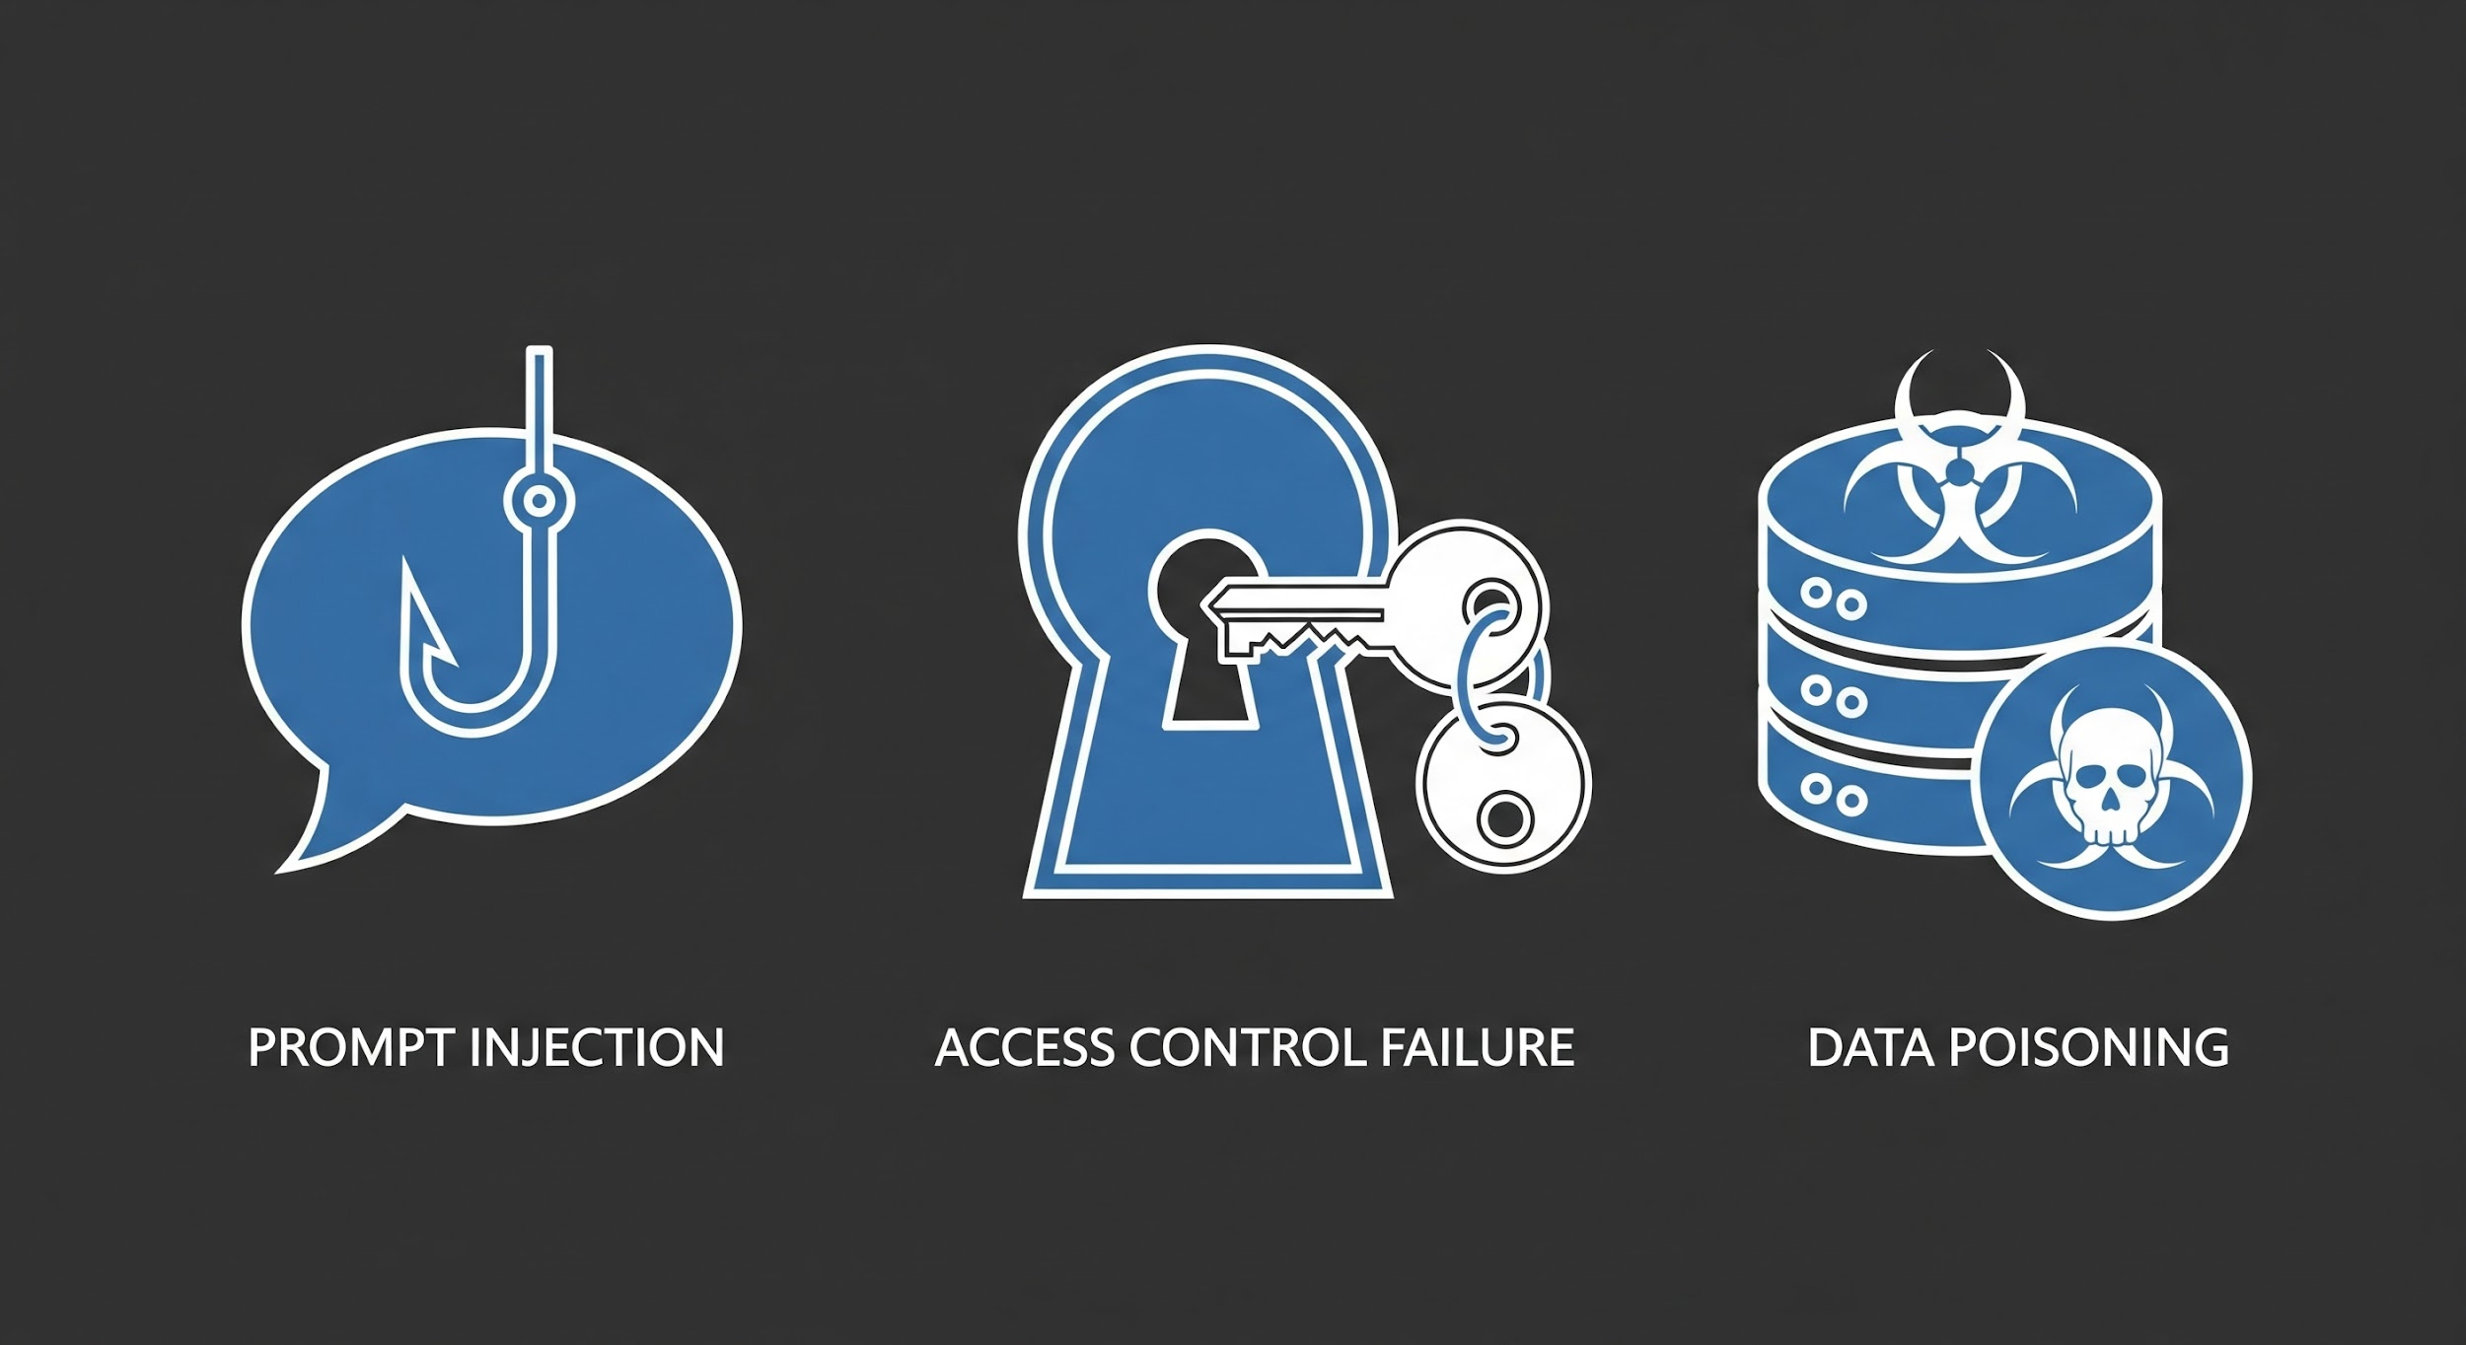
Traditional Threats are Being Amplified by AI
Notes:
For Prompt Injection & Business Logic Abuse: Think of this as the new form of phishing for the AI era. Attackers use malicious instructions to trick our authorized AI agents into abusing their legitimate permissions. Because the agent is already trusted, its actions bypass our traditional defenses, allowing attackers to exfiltrate data or manipulate systems from the inside.
For Pervasive Access Control Failures: To make AI agents work quickly, there's a huge temptation to grant them overly broad permissions. This is like giving a new intern the master key to the entire building. If that one agent is compromised, the attacker instantly gains access to a vast range of sensitive data and systems, creating a massive breach from a single point of failure.
For Data Poisoning & Model Theft: Our AI models are a critical intellectual property asset, and they are only as good as the data they're trained on. Attackers can target the APIs that feed these models to subtly corrupt the data, leading to flawed business decisions and biased outcomes. They can also use APIs to probe and steal the models themselves, compromising our competitive advantage.

Slide 10
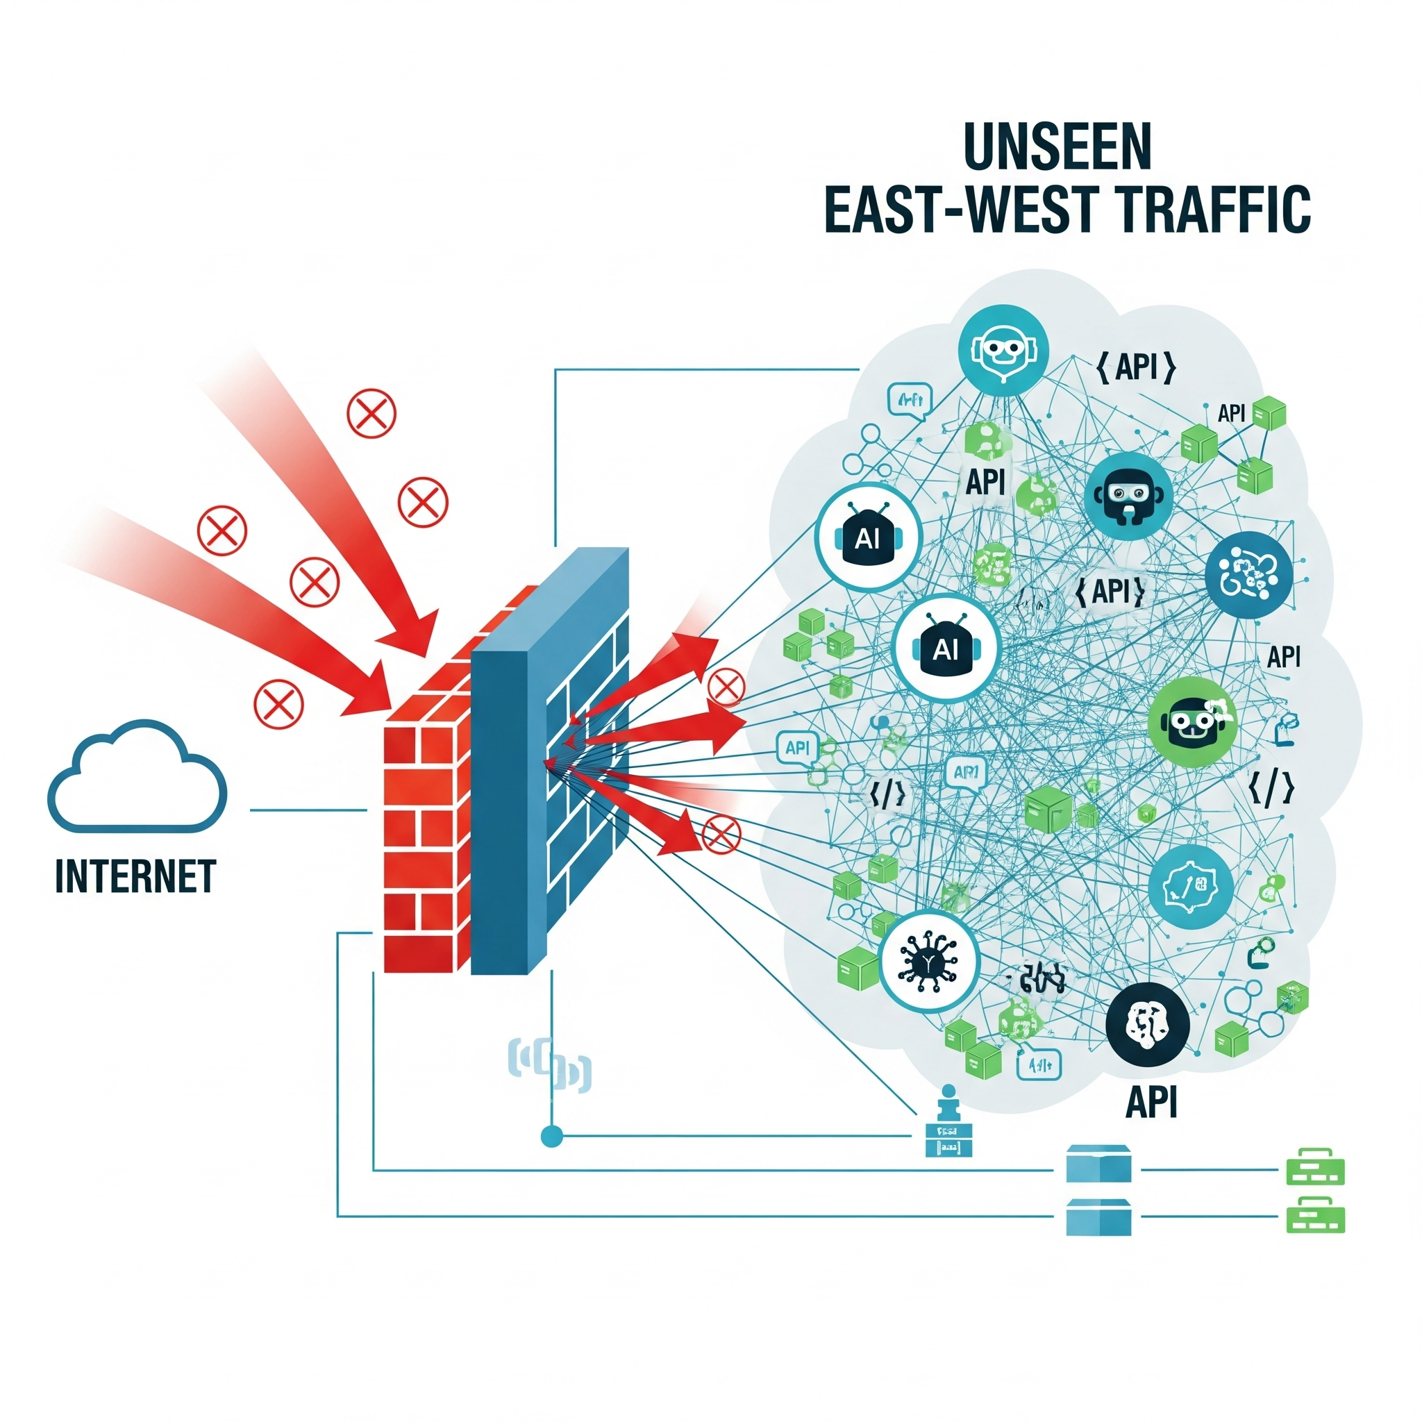
Our Current Security Stack Has Critical AI Blind Spots
WAFs & API Gateways: Are blind to "low-and-slow" attacks and business logic abuse by compromised agents.
Cloud Security (CSPM): Secures the infrastructure around our apps but not the API traffic within them.
The Bottom Line: Our existing tools were not built to understand the behavior of autonomous agents.

Slide 11
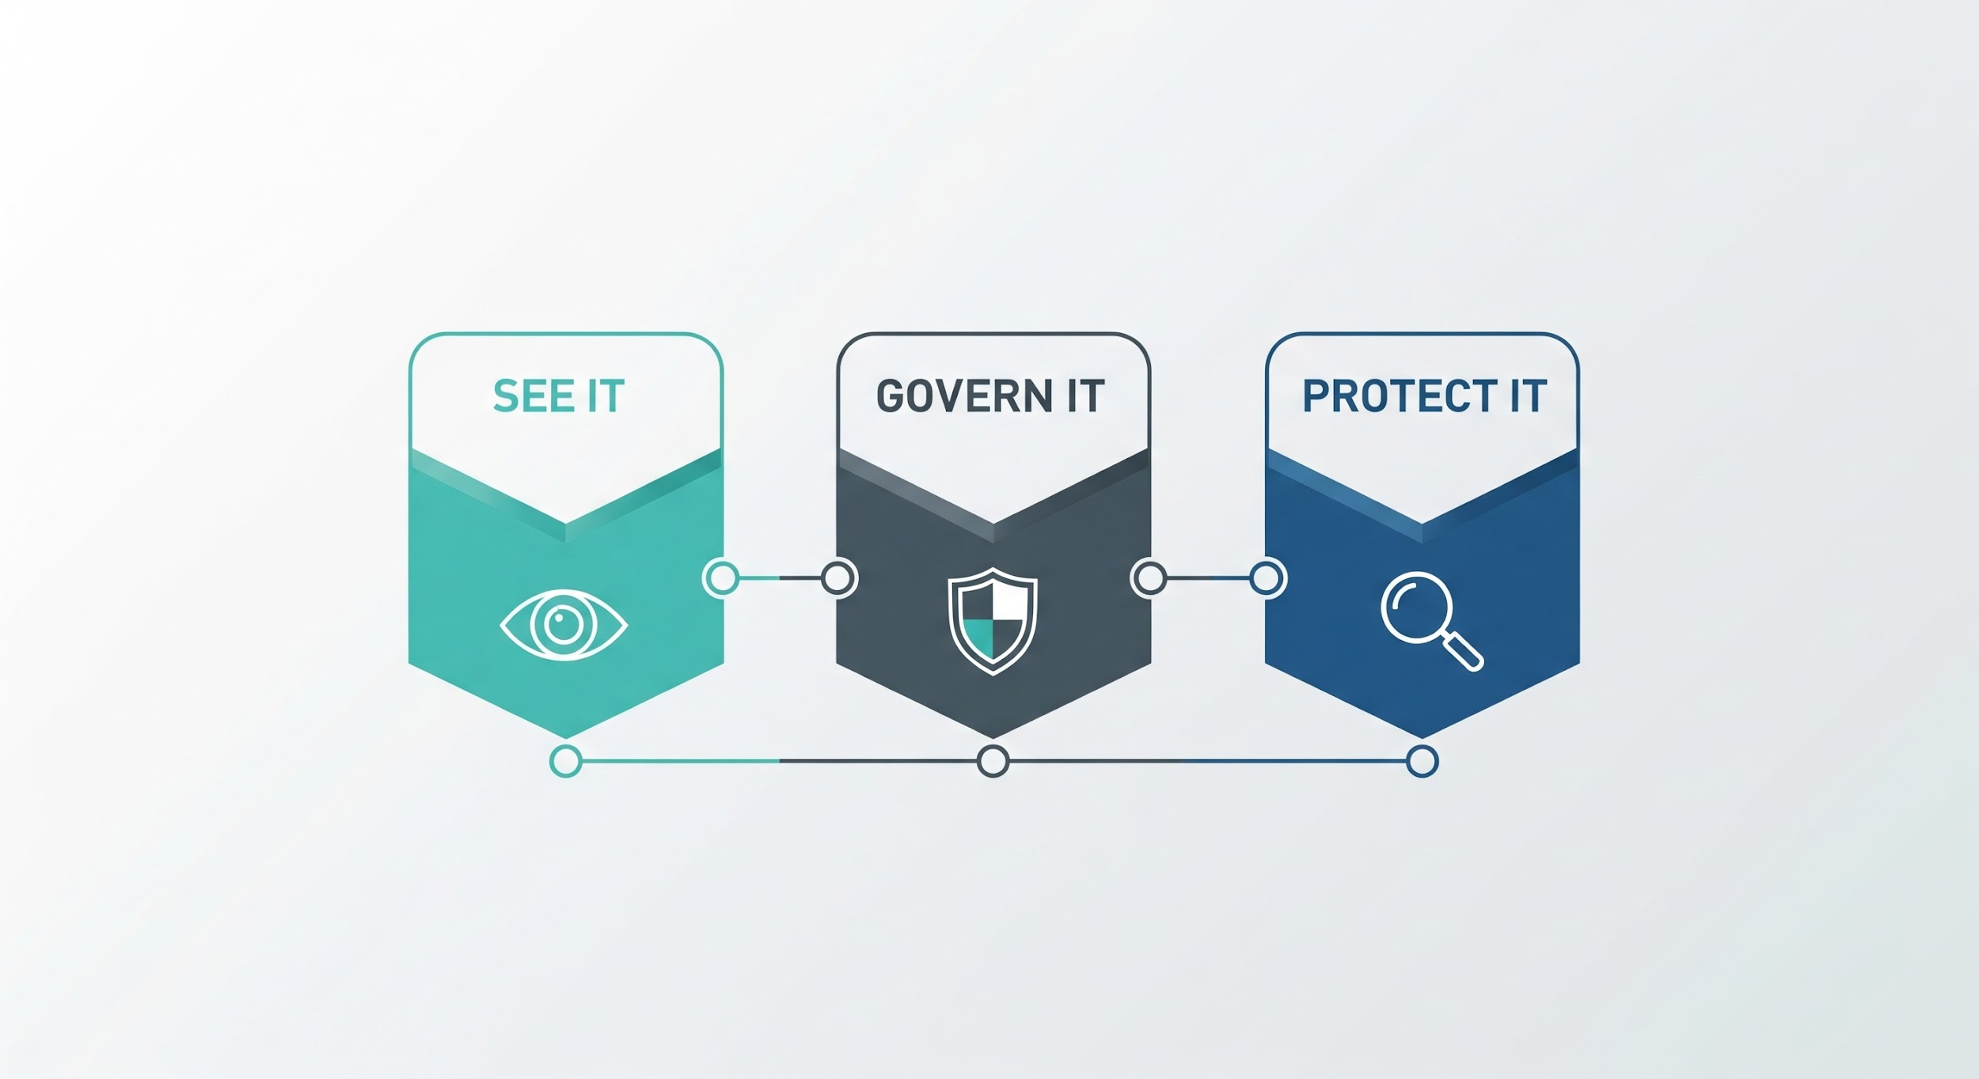
A Proven, 3-Pillar Strategy for Governing Agentic AI
Notes:
To address these new risks, we are not proposing to rip and replace our existing tools. Instead, we are proposing to augment them with a new layer of security intelligence focused on the API layer. Our strategy is built on three simple, powerful pillars: See It, Govern It, and Protect It.

Slide 12
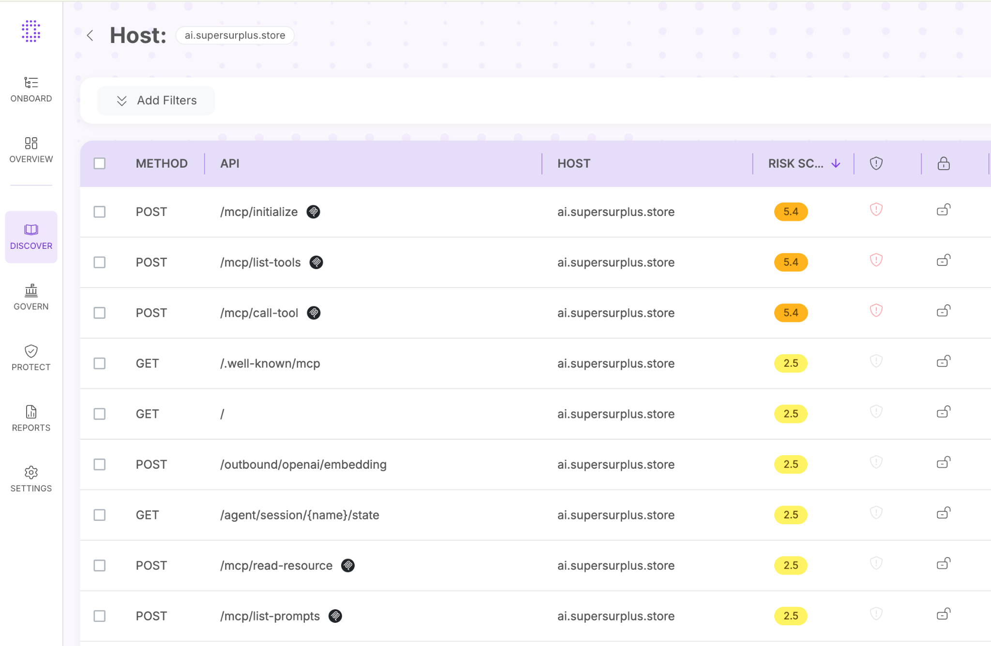
The Foundational Questions We Must Be Able to Answer
[ ] Do we have a real-time, continuously updated inventory of ALL APIs?
[ ] Can we automatically identify all APIs that handle sensitive data?
[ ] Do we have an "attacker's view" of our external API attack surface?
Notes:
The first pillar is visibility. These are the critical questions we need to be able to answer with confidence. Today, our ability to answer them is limited and relies on manual processes.

Slide 13
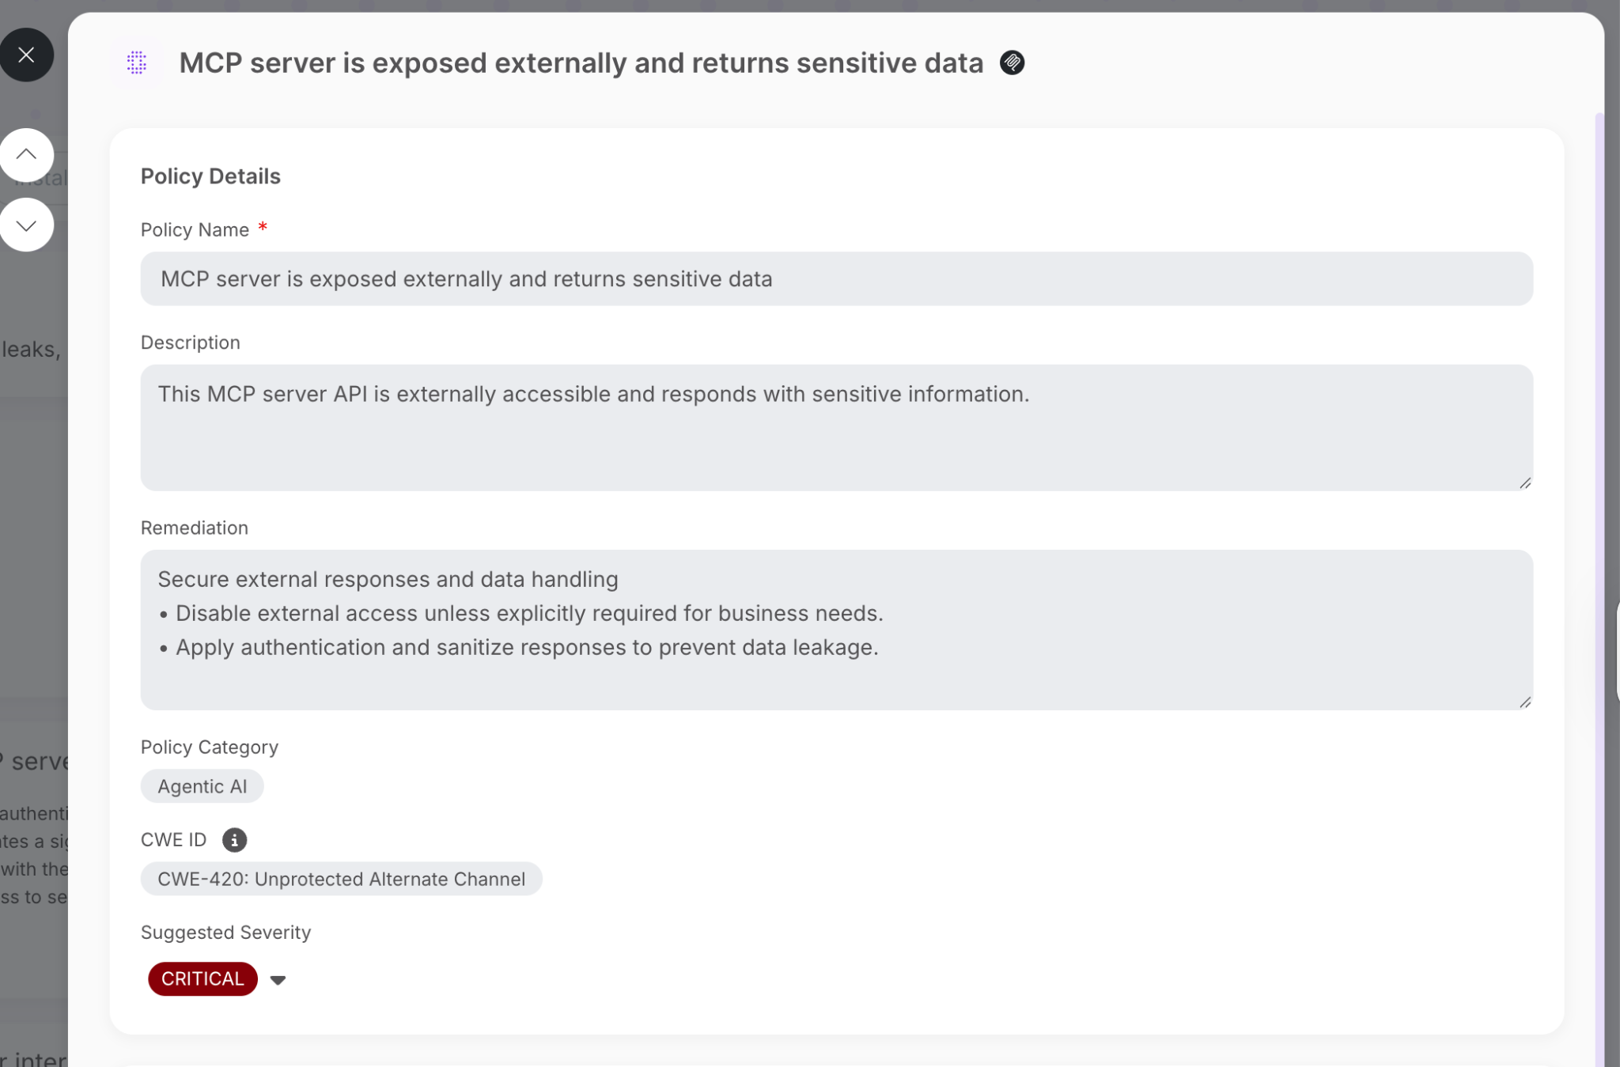
Addressing Our Known Posture and Compliance Gaps
Authentication: Inconsistent authentication methods across our API landscape.
Authorization: Lack of granular access controls for machine identities.
Compliance: No automated way to map our API posture to emerging regulations.
Notes:
The second pillar is governance. Based on our internal assessments, we know we have gaps in these key areas. A formal governance program will allow us to systematically close these gaps, shrink our attack surface, and ensure we are compliant.

Slide 14
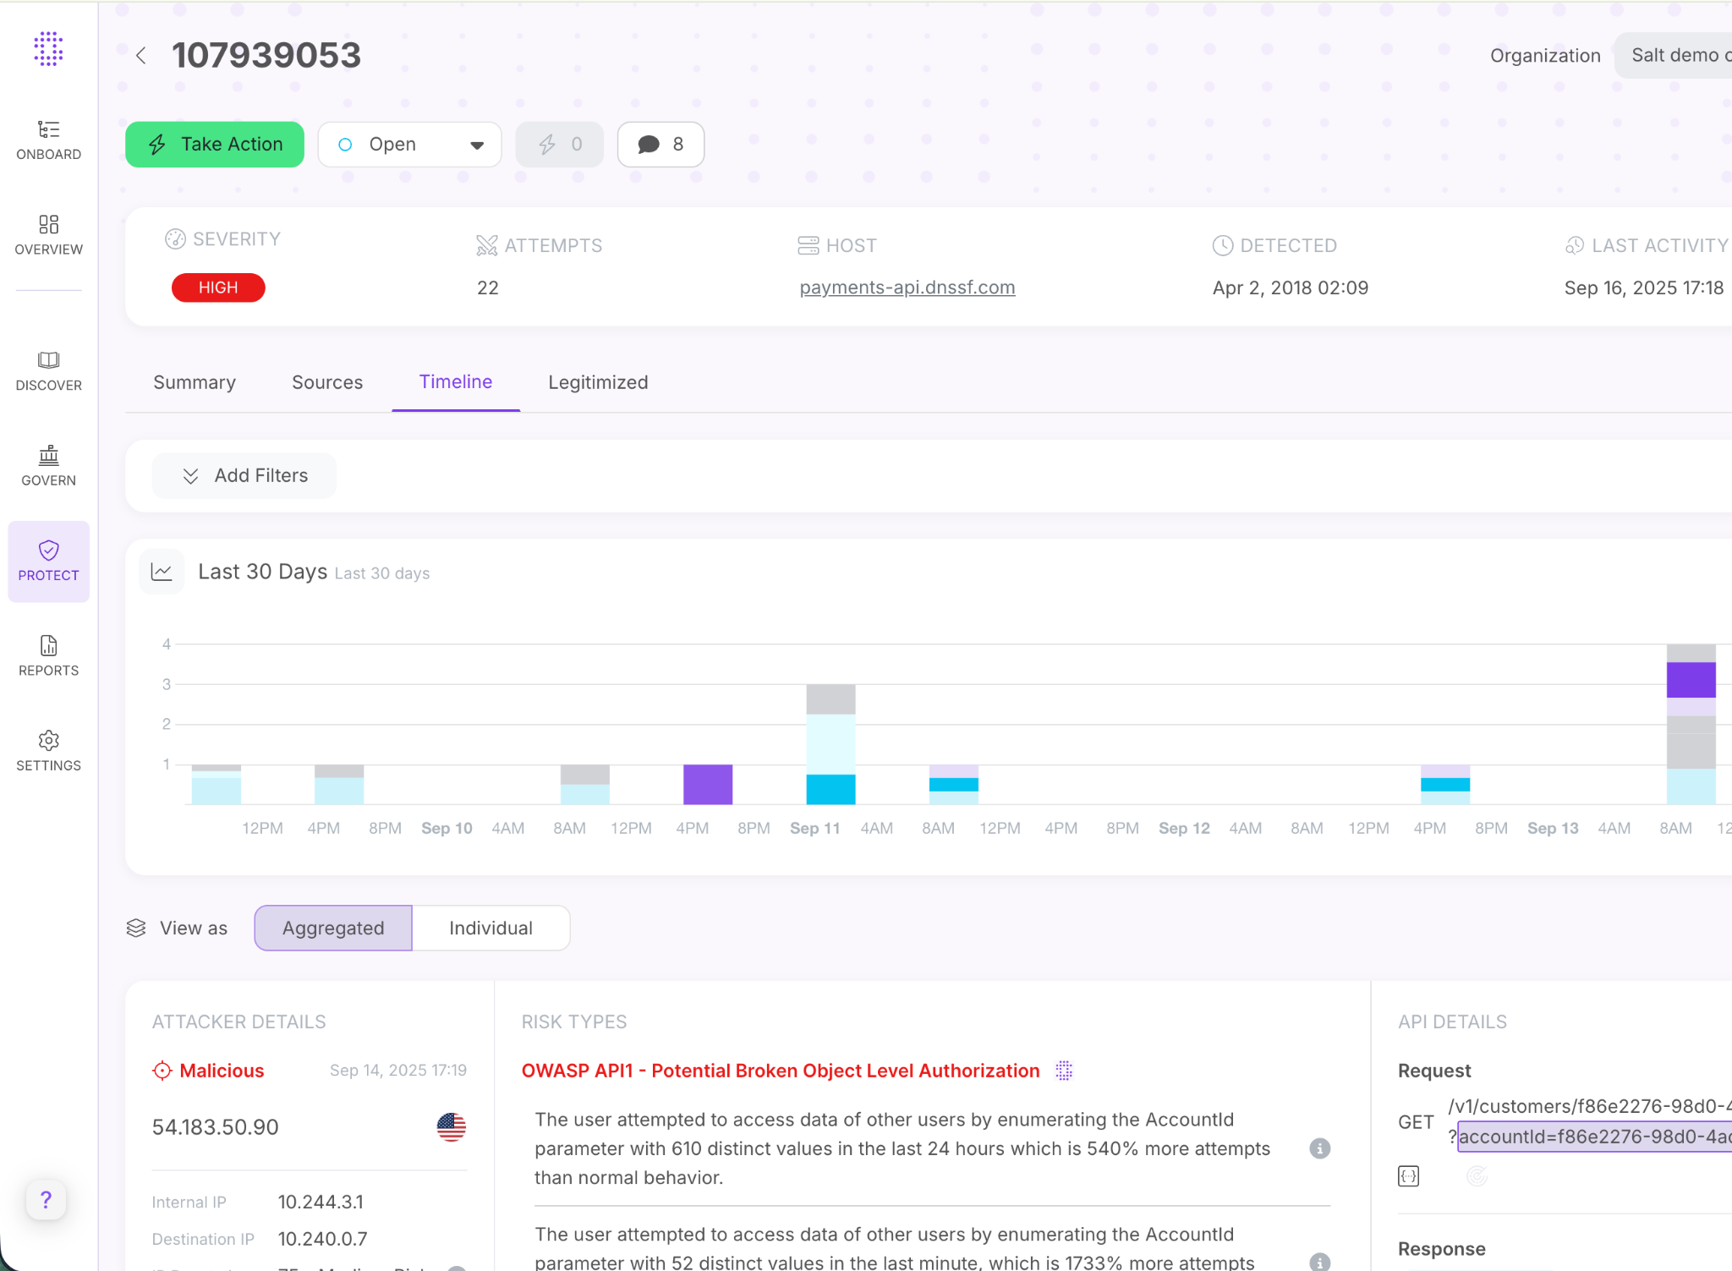
Scenario: A Compromised Agent Exfiltrating Data
A visual, step-by-step diagram of a "low-and-slow" attack.
Attacker uses prompt injection to compromise a legitimate AI agent.
Agent makes a series of individually valid API calls to probe for data.
Agent slowly exfiltrates sensitive PII, staying below rate limits.
Question: How would our current security stack detect this?
Notes:
The final pillar is protection. Let's walk through a realistic attack. A WAF wouldn't see this because each individual API call is technically valid. This is a behavioral, context-based attack, and it requires a behavioral, context-based defense to stop it.

Slide 15
How Our 3-Pillar Framework Meets Key AI Regulations
Regulatory Requirement (EU AI Act & ISO 42001) | Our API Security Strategy | How We Achieve It
Data Integrity & Governance | See It & Govern It | We discover all APIs handling AI data and govern their posture to prove data integrity and prevent data poisoning.
System Robustness & Cybersecurity | Govern It & Protect It | We govern our API posture to remove vulnerabilities and protect against real-time attacks, proving our AI systems are resilient.
Traceability & Human Oversight | See It & Protect It | We discover and log every API call to provide a complete, immutable audit trail for forensic investigation.
Notes:
Our 'See, Govern, Protect' strategy is not just a security framework; it's a compliance framework. As this table shows, each pillar directly maps to the core requirements of emerging AI regulations. By securing our APIs, we are building a foundation of demonstrable compliance.

Slide 16
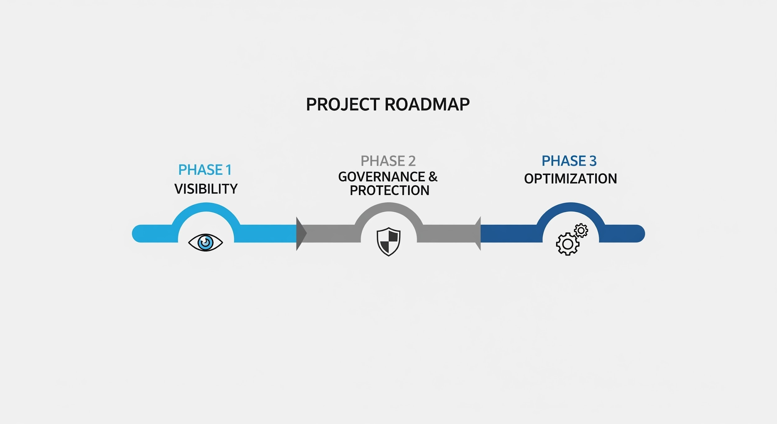
Our Plan for Securing Our AI Initiatives
Phase 1 (Next 30 Days): Gain Complete Visibility
Phase 2 (Next 60 Days): Establish Governance & Runtime Protection
Phase 3 (Ongoing): Continuous Optimization
Notes:
As we've discussed, our current tools have significant blind spots when it comes to the dynamic and behavioral nature of AI. To execute this 3-phase plan and close these critical gaps, we need to bring in a specialized solution that is purpose-built for AI and API security.
My recommendation is to move forward with a Proof of Concept for a dedicated platform that can provide the real-time visibility, governance, and threat protection we require. I am requesting this team's support to initiate this evaluation process next week. Thank you

Slide 17
Open Discussion

Slide 18
Thank you

